Slide 1

Mudra Classification
Department of CSE
Jyothi Engineering College
Thrissur
January 20, 2021

Slide 2
Group Number : 15
Project Title : Mudra Classification
https://github.com/saurav-alt/Group15
Group Guide : Ms. Ninu Francis
Asst. Professor
Department of CSE
Group Members : Saurav Mundanatt Satheesh Kumar JEC17CS091
Muhammed Afthab V U JEC17CS070
Sandra David JEC17CS084
Sruthi Elsa Shaji JEC17CS100
20/01/21
CSE Department, JECC

Slide 3
Vision of the Department
Creating eminent and ethical leaders in the domain of Computational Sciences through quality professional education with a focus on holistic learning and excellence.
Mission of the Department
To create technically competent and ethically conscious graduates in the field of Computer Science and Engineering by encouraging holistic learning and excellence.
To prepare students for careers in Industry, Academia and the Government.
To instill Entrepreneurial Orientation and research motivation among the students of the department.
To emerge as a leader in education in the region by encouraging teaching, learning, industry and societal connect.
20/01/21

Slide 4
Contents
Introduction
Project Abstract
Existing System
Literature Survey
Proposed System
Application
Conclusion
Reference
20/01/21
CSE Department, JECC

Slide 5
Introduction
Indian classical dance has been part of Indian Culture from around 200 BC
These classical dance forms is named ‘Natya Rasa’ in the Sanskrit text ‘Natya Shastra’
According to Natya Shastra there exists 108 karanas (action of hands, feet and body)
A hasta mudra is a symbolic gesture of hand which is used as a support for visual communication
This work inquires into the possibility of identifying hasta mudras in various classical dance forms of India
20/01/21
CSE Department, JECC

Slide 6
Project Abstract
Every classical dance form portrays a core idea, story, etc.
Not everyone are expertise in understanding that idea, nor do everyone knows what each pose portrays
The work attempts to find the feasibility of identifying the hasta mudra depicted in a classical dance form and define its meaning
The images are to be extracted from the video input
The hand data is to be preprocessed and features are to be extracted
The classification is by the Faster R-CNN
20/01/21
CSE Department, JECC

Slide 7
Objectives
To classify the hasta mudras of a classical dance performance from a video
To convey the exact meaning of a classical dance to the viewer
20/01/21
CSE Department, JECC

Slide 8
Existing System
There exists different proposals for mudra classification
But the existing systems revolve around classification from images
The widespread use of mobile devices such as smart phones and tablets either
for work or communication has enabled the people to easily access application
in different domains.
The existing systems include classification using HOG and SVM, skeletal
features, polygon representation, CNN, etc.
Advantages
Gesture recognition is also helpful for physically disabled persons to
communicate with the system
20/01/21
CSE Department, JECC

Slide 9
Mudra identification along with other modules can help in building an online
learning system for the Indian dance form and provide a global exposure to the
Indian classical dance
Disadvantages
Time consuming
High computation power required
One cannot make long explanation or conversation through gesture.
For image based gesture recognition there are limitations on the
equipment used and image noise. Images or video may not be under
consistent lighting etc.
20/01/21
CSE Department, JECC

Slide 10
Literature Survey
On the classification of Kathakali hand gestures using support vector machines
and convolutional neural networks :
. The paper proposed an SVM model and CNN model which classifies the images
. A better classification system for Kathakali where hand mudras are complex
. Classifies single hand mudras only
Two-level classification scheme for single-hand gestures of Sattriya dance:
. In the first level, SVM was used to classify an unknown hasta image into
one of three groups and, in the second level Decision Tree classifier was used to
recognize the hasta within the group
. The accuracy during first level is 98%
. The accuracy at second level of classification is not very encouraging
20/01/21
CSE Department, JECC

Slide 11
Heterogeneous hand gesture recognition using 3D dynamic skeletal data :
. The statistical representation, Fisher Vector and the temporal representation
method, Temporal Pyramid are used for the encoding of descriptors
. Takes into consideration the hand shapes, orientation and movement of hand
. The task is time consuming as more steps are included
Artificial neural network based identification and classification of images of
Bharatanatya gestures :
. The project made an attempt to identify the hand mudra using image-
processing and also pattern recognition methods
. The system works well with both single and double handed gestures
20/01/21
CSE Department, JECC

Slide 12
Proposed System
The proposed system classifies the hasta mudras depicted in a classical dance form video and give its meaning
The classification of hand mudras from a dance video is a less focused area of study
The goal is to aspire the viewers to enjoy the classical dance and get proper recognition when more people get to appreciate the art forms
The steps are divided as:
1. Hand gesture frame acquisition
2. Hand tracking
3. Feature extraction
4. Classification
20/01/21
CSE Department, JECC

Slide 13
Modules
Data Acquisition Module:
The images are captured from the video input
The hand position from the images are tracked
80% of the dataset is used as training data and 20% is used as test data
Data Pre-processing Module:
The step of data pre-processing plays a very important role in contributing
to the accuracy of any training model
20/01/21
CSE Department, JECC

Slide 14
Annotation
Annotating an image with labels.
Requires labellers to draw a box as close as possible to the edges of key objects within the image.
Classification Module:
The module identifies and classifies the given data
Faster R-CNN is used for classification
Faster R-CNN makes testing section faster and accuracy greater than other
methods
Inception acts as the backbone of network
20/01/21
CSE Department, JECC

Slide 15
SRS
Functional Requirements
User interface
This is the user interface module where the user can input the video
The various mudras are identified and gives out a brief description to the
user as output
Data Pre-processing and Feature Extraction
The video data of hand mudras of various classical dances are collected
Then image segmentation and feature extraction are done followed by
training of dataset by Faster R-CNN algorithm and get output as text
messages
20/01/21
CSE Department, JECC

Slide 16
Non-Functional Requirements
Performance Requirements
The software identifies the hand gestures accurately.
Better prediction time
Extensibility
The software is extensible to allow various gesture recognition features to be added to system.
Efficiency
Optimum use of the system resources.
20/01/21
CSE Department, JECC

Slide 17
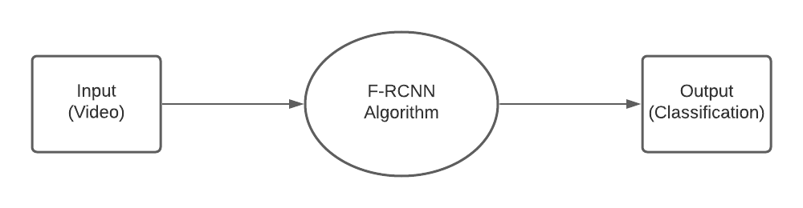
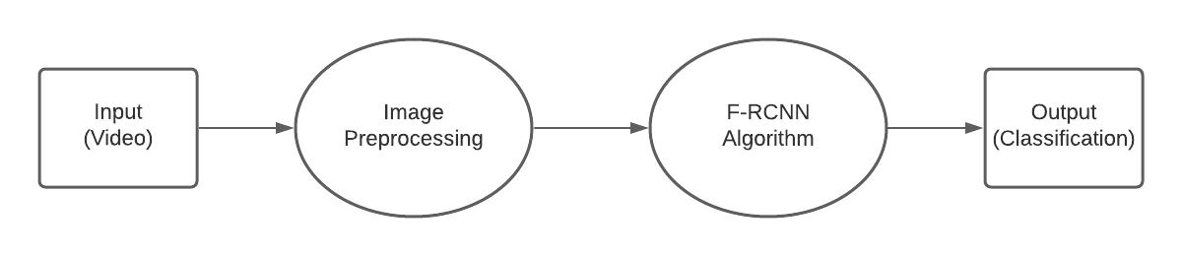
DFD
Level 0
Level 1
20/01/21
CSE Department, JECC

Slide 18
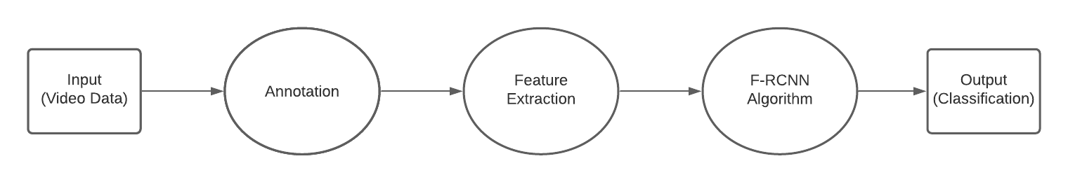
Level 2
20/01/21
CSE Department, JECC

Slide 19
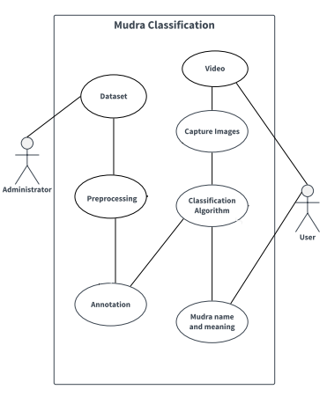
Use Case Diagram
20/01/21
CSE Department, JECC

Slide 20
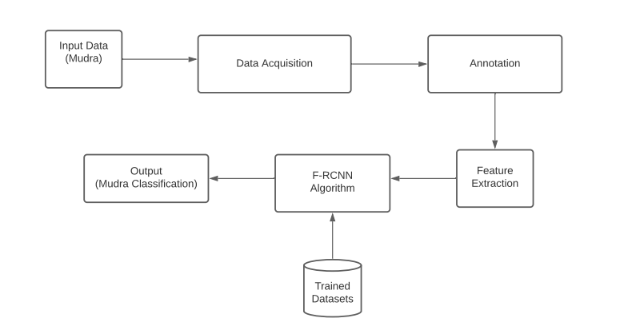
Architectural Diagram
20/01/21
CSE Department, JECC

Slide 21
Applications
The system can be used to rightfully convey the meaning of a classical dance form among the common people who wish to enjoy the it
The system can even be utilized for online dance tutorials
While telecasting a dance video, the system can be used to provide the description of the dance theme as subtitles
20/01/21
CSE Department, JECC

Slide 22
Pending Works
The dataset for the model is to be populated
The model is implemented and coded
The model is to be trained using the training data
The model is to be tested for accuracy
20/01/21
CSE Department, JECC

Slide 23
Conclusions
The classical dance forms play a vital role in enriching the heritage of India
An attempt is made to explore the possibility of identifying the mudras in the classical dance video
The work makes an effort to help the viewer identify the exact mudra depicted in a dance form and gives a brief description of it
The viewer who aspires to enjoy the classical dance form to its fullest is benefited
The Indian classical dance forms get proper recognition when more people get to appreciate the art forms
20/01/21
CSE Department, JECC

Slide 24
Course Outcome
C410.1 The students will be able to analyse a current topic of professional
interest and present it before an audience.
C410.2 Students will be able to identify an engineering problem, analyse it and
propose a work plan to solve it.
C410.3 Students will have gained thorough knowledge in design,
implementations and execution of Computer science related projects.
C410.4 Students will have attained the practical knowledge of what they learned
in theory subjects.
C410.5 Students will become familiar with usage of modern tools.
C410.6 Students will have ability to plan and work in a team.
20/01/21
CSE Department, JECC

Slide 25
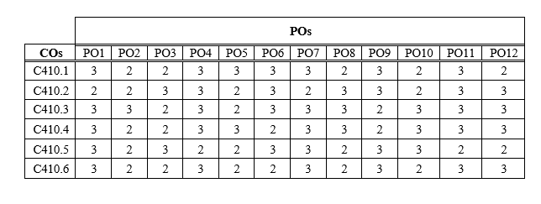
Course Outcome
20/01/21
CSE Department, JECC

Slide 26
Reference
[1] Kumar K.V.V., Kishore P.V.V. (2018) Indian Classical Dance Mudra Classification Using
HOG Features and SVM Classifier. In: Satapathy S., Bhateja V., Das S. (eds) Smart Computing
and Informatics. Smart Innovation, Systems and Technologies, vol 77. Springer, Singapore
[2] L. T. Bhavanam and G. Neelakanta Iyer, "On the Classification of Kathakali Hand Gestures
Using Support Vector Machines and Convolutional Neural Networks," 2020 International
Conference on Artificial Intelligence and Signal Processing (AISP), Amaravati, India, 2020, pp.
1-6, doi: 10.1109/AISP48273.2020.9073398
[3]M. Devi and S. Saharia, "A two-level classification scheme for single-hand gestures of Sattriya
dance," 2016 International Conference on Accessibility to Digital World (ICADW), Guwahati,
2016,pp. 193-196, doi: 10.1109/ICADW.2016.7942540
[4] S. Saha et al., "Bharatanatyam hand gesture recognition using polygon representation," Proceedings
of The 2014 International Conference on Control, Instrumentation, Energy and Communication
(CIEC), Calcutta, 2014, pp. 563-567, doi: 10.1109/CIEC.2014.6959152
[5]Quentin de Smedt, Hazem Wannous, Jean-Philippe Vandeborre. Heterogeneous hand gesture
Recognition using 3D dynamic skeletal data. Computer Vision and Image Understanding, Elsevier,
2019,181, pp.60-72. _xffff_10.1016/j.cviu.2019.01.008_xffff_. _xffff_hal-02420779
20/01/21
CSE Department, JECC

Slide 27
Thank You
CSE Department, JECC
20/01/21

